Slide 1


Introducing Microsoft Fabric

Slide 2
Agenda
What Is Fabric
Why Fabric
OneLake
Single Source of Truth
Report Demo
Pricing
PowerBI Copilot video
How to enable in your organisation
Notes:
What is Fabric
End to End Analytics Platform
Key Points
One Lake
Single source of truth
PowerBI Copilot
Pricing
How to set up environment

Slide 3
Microsoft Fabric
Infrastructure simplification
Improve operations efficiency
Data Governance
Notes:
Top level focus

Slide 4
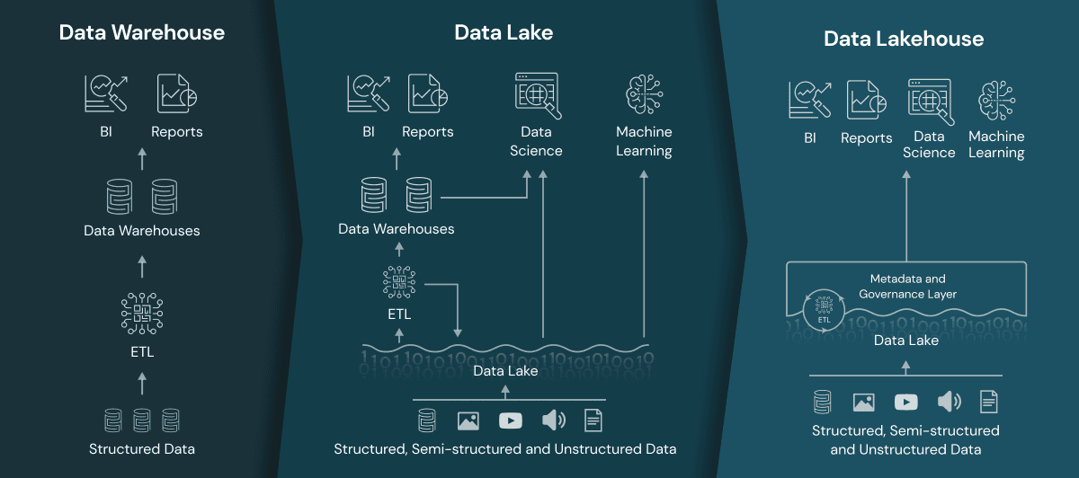
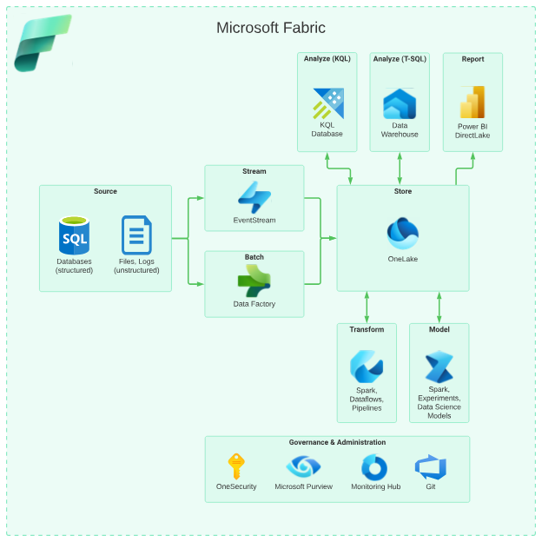
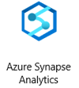

Data Analytics Evolution
Data analytics for the era of AI
SQL Server PDW
Started 1990’s
2010- 2016
2016 - Now
2023 - Fabric
Notes:
We’ll start with historical perspective.
Micorsoft Data Platform is very mature and it evolves together with the industry.
From left to right.
Back in 1990 the computers were relatively expensive both in terms of memory and storage, and the typical reporting architecture would look like shown in the left hand slide. Because it is never a good idea to run reporting off the production database the industry settled on Data Warehouse architecture, and ETL processes copying the data from production database to Data Warehouse. Because the storage was expensive data was mostly structured.
Around 2010, the computers became a lot more accessible memory and storage got seriously cheaper and organisations already accumulated a lot of unstructured data in form of image files, videos and perhaps audios. Big data also led to advancements in data science and Machine Learning and that affected the usage patterns: you want a lot of data to be accessible reasonably fast by very different type of workloads. Around that time Microsoft introduced Microsoft SQL Server Parallel Data Warehouse, and we can think of it as the first iteration of Data Platform and also as a grand father of Fabric.
PDW was an on-prem solution combining both hardware and software and usually involved large on-prem installation and commitment.
From 2016 onward, The Cloud took off, and it didn’t make a lot of sense to invest in large on-prem infrastructure as the data moved to The Cloud. Data Governance also became very important as in “now we have a lot of data – and we need to manage the risks associated with it” hence the Data Governance. Around that time Microsoft introduced Azure Synapse as the Data platform covering that functionality. Around that time we have also decided to split the storage from compute, as most of time you do not need to keep the powerful compute always running in order to query the data.

Slide 5

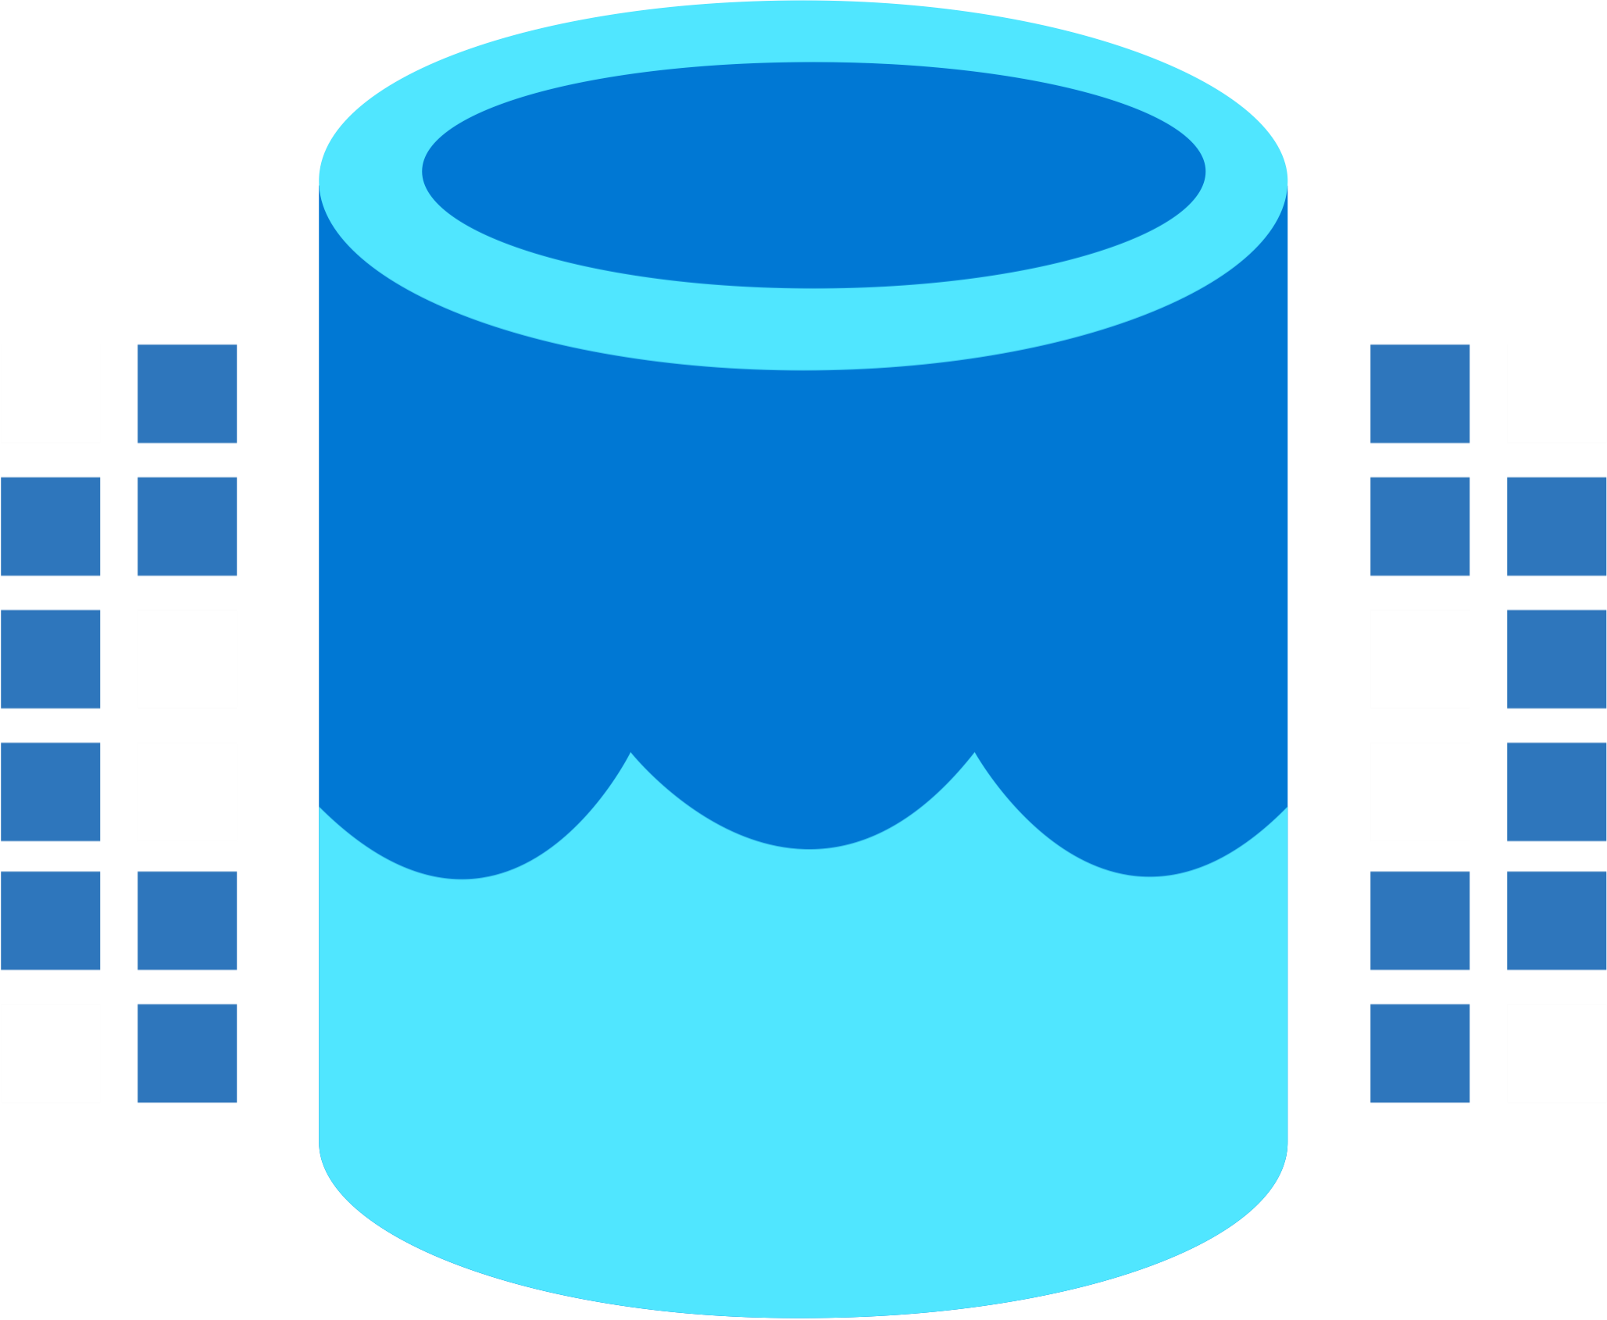
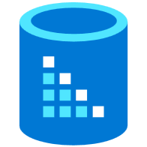

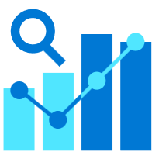

Microsoft Fabric
Data Integration
Data Lake
Spark Engines
Data
Warehouse
Real Time Analytics
Data
Science
Business
Intelligence
Governance
Unified analytics fabric
End-to-end analytics data fabric
From the data lake to the business user
Notes:
Microsoft Fabric is an all-in-one analytics solution for enterprises that covers everything:
data movement
data science,
Real-Time Analytics,
and business intelligence.
It offers a comprehensive suite of services, including data lake, data engineering, and data integration, all in one place.
With Fabric, you don't need to piece together different services from multiple vendors. Instead, you can enjoy a highly integrated, end-to-end, and easy-to-use product that is designed to simplify your analytics needs.
The platform is built on a foundation of Software as a Service (SaaS) model, which takes simplicity and integration to a whole new level.
With Microsoft Fabric, we go from a collection of products to a Unified Analytics Platform that brings end-to-end analytics from the data lake to the business user

Slide 6
Why Fabric
Democratize Analytics
Persona Experience
Simplify
Operations
Deployment
Administration/Management
Pricing
Single Source of Truth
OneLake
One Security
Open but Secure
Part of Microsoft Platform
Seamless integration
Data
Integration
Data
Engineering
Data Warehousing
Real-
Time Analytics
Data Science
Business Intelligence
AI Assisted
Shared Workspaces
Universal Compute Capacities
OneSecurity
OneLake
The Intelligent Data Fabric
Notes:
Microsoft Fabric is build around Persona centric workflow (starting from Data Engineer to a Citizen Data Analyist). Each Role or Persona is presented with a set of tasks and work windows typically associated with them. For example Data Engineer will be mostly interested in Pipelines, Notebooks and perhaps SQL Endpoint, whereas Citizen Data analysts will be interested in Semantic Data Models (formerly known as DataSets) available in the organisation and reports that can be built on top of them.
The aim is to simplify all aspects of Business Intelligence and Analytics in the organisation, where previously you needed to deploy multiple products from variety of vendors, in Fabric with simple 1 click deployment you will have all the features necessary. Even compared with a traditional Synapse deployment containing dozen of Azure Services in Fabric it is all rolled into one.
One Lake is a single, unified, logical data lake for your whole organization. Like OneDrive, OneLake comes automatically with every Microsoft Fabric tenant and is designed to be the single place for all your analytics data. To separate the data between different users or business group Lakehouses are used and you can deploy as many as you like.

Slide 7
Microsoft Fabric
End-to-end analytics data fabric
From the data lake to the business user
Complete Analytics Platform
Best of Breed
Unified SaaS Solution
Low Code Plus Pro Dev
Lake-centric and Open
OneLake
One Copy
Always Synced
Empower Every Office User
Familiar and Intuitive
Built Into Office
Insight to Action
Persistent Security and Governance
End-to-End Visibility
Always Governed
Secure by Default
Notes:
Microsoft Fabric integrates Power BI, Data Factory, and the next generation of Synapse to offer customers a price performant and easy-to-manage modern analytics solution for the era of Artificial Intelligence.
Microsoft Fabric delivers an integrated and simplified experience for all analytics workloads and users on an enterprise grade data foundation. It is a product for the entire enterprise—complete with role-tailored tools, deep integrations with Microsoft Office and Teams, and AI Copilots to accelerate analytics capabilities and help scale data value creation for everyone from data professionals to non-technical business users. It enables persistent data governance and a single capacity pricing model that scales with your growth—and it’s open at every layer with no proprietary lock-ins. With Microsoft Fabric, you can empower everyone to unlock more value from data.

Slide 8
It’s SaaS
“it just works”
5x5
Frictionless onboarding
Instant Provisioning
Quick Results w/Intuitive UX
Success by default
Minimal knobs
Auto optimized
Auto integrated
Centralized Administration
Tenant-wide governance
Centralised security management
Compliance built-in
Notes:
5x5 = 5 seconds to sign up
5 minutes to wow

Slide 9
OneLake for all Data
“The OneDrive for Data”
Data
Warehousing
Data
Engineering
Data Integration
Data
Science
Real
Time
Analytics
Business Intelligence
A single SaaS lake for the whole organization
Provisioned automatically with the tenant
All workloads automatically store their data in the OneLake workspace folders
All the data is organized in an intuitive hierarchical namespace
The data in OneLake is automatically indexed for discovery, MIP labels, lineage, PII scans, sharing, governance and compliance
OneLake Storage
Intelligent data fabric
Notes:
OneLake is at the core of Fabric experience.
You can think of OneLake as the OneDrive for Data. This is a Software as a Service lake for your whole organization that allows you to access and store data in a single location, so that your Spark jobs can operate against a single of truth and allow you to produce insight and analytics in a unified fashion. This will also allow you to organize your data in an intuitive hierarchal namespace, and enable indexing for discovery using Microsoft Information Protection labels, lineage, and Personally Identifiable information scans to enforce governance and compliance on data stored in the OneLake.

Slide 10
Microsoft Fabric
Single…
Data
Integration
Data
Engineering
Data Warehousing
Real-
Time Analytics
Data Science
Business Intelligence
Onboarding and trials
Sign-on
Navigation model
UX model
Workspace organization
Collaboration experience
Data Lake
Storage format
Data copy for all engines
Security model
CI/CD
Monitoring hub
Data Hub
Governance & compliance
AI Assisted
Shared Workspaces
Universal Compute Capacities
OneSecurity
OneLake
The Intelligent Data Fabric
Notes:
Fabric is a single source of truth for all your data.
Additionally, this unification concept enables a single mechanism for onboarding and signing into the Microsoft Fabric service. Access is granted in a unified way, copying & pasting through various different forms that these workloads use in their user interfaces is common. And of course, the security model is shared between these services, meaning… that if you have access restrictions enforced on data in one area, they can be inherited and applied to all areas of your analytics pipeliine.

Slide 11
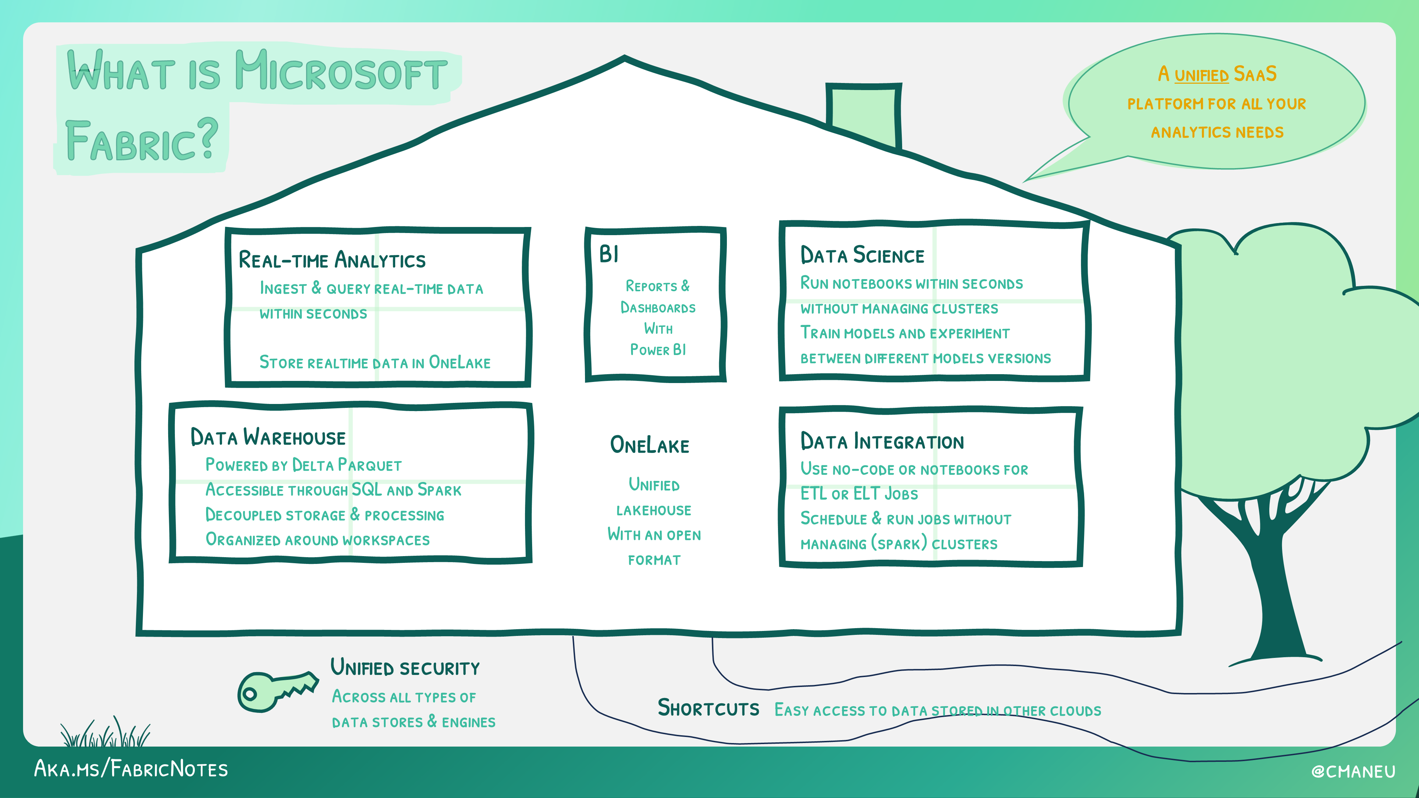
Notes:
Altogether
A significant upgrade to analytics engine: all around improved, faster and more scalable
Complete Analytics Platform combining:
Fabric SQL Engine - for standard workloads
Direct Lake - direct access to Lakehouse
Fabric Spark - run Spark workloads directly in Fabric
Real-Time Analytics - streaming and time series data analysis
Simplified Lakehouse architecture
Unified Open Source data format allows for using the data as is without copying
New Data Access options:
Shortcuts
Database mirroring
Seamless access to Dataverse and M365

Slide 12









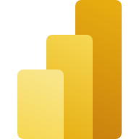




Data Engineers
Data Scientists
Data Analysts
Data Citizens
Execute faster with the ability to spin up a Spark VM cluster in seconds, or configure with familiar experiences like Git DevOps pipelines for data engineering artifacts
Streamline your work with a single platform to build and operate real-time analytics pipelines, data lakes, lake houses, warehouses, marts, and cubes using your preferred IDE, plug-ins, and tools.
Reduce costly data replication and movement with the ability to produce base datasets that can serve data analysts and data scientists without needing to build pipelines
Quickly tune a custom model by integrating a model built and trained in Azure ML in a Spark notebook
Work faster with the ability to user your preferred data science frameworks, languages, and tools
Bypass engineering dependencies with the ability to use your preferred no-code ML Ops to deploy and operate models in production
Tap into proven-at-scale models and services to accelerate your AI differentiation (AOAI, Cognitive Services, ONNX integration, etc).
Avoid slow, progress-stagnating data wrangling by seamlessly triggering a workflow that can unlock data engineering tools and capabilities quickly.
Accelerate your work with visual and SQL based tools for self-serve data transformations and modeling as well as self-serve tools for reporting, dashboards, and data visualizations
Turn data into impact with industry-leading BI tools and integration with the apps your people use everyday like Microsoft 365
Make more data-driven decisions with actionable insights and intelligence in your preferred applications
Maintain access to all the data you need, without being overwhelmed by data ancillary to your role thanks to fine grain data access management controls
Act on data, at scale and in a timely manner by describing business conditions in a no-code experience to launch actions such as Email, Teams notifications, Power Automate flows and call into third party action systems.
Serve data via warehouse or lakehouse
Serve transformed data
Serve insights via embedding
Supporting experiences:
Supporting experiences
Supporting experiences
Supporting experiences
Data Factory
Data Warehouse
Data Science
Azure ML
Data Warehouse
Real-time Analytics
Power BI
Power BI
Data Activator
Microsoft 365
Data Engineering
Real-time Analytics
Serve data via warehouse or lakehouse
Data Stewards
Maintain visibility and control of costs with a unified consumption and cost model that provides evergreen spend optics on your end-to-end data estate
Gain full visibility and governance over your entire analytics estate from data sources and connections to your data lake, to users and their insights
Notes:
Envisioned personas

Slide 13
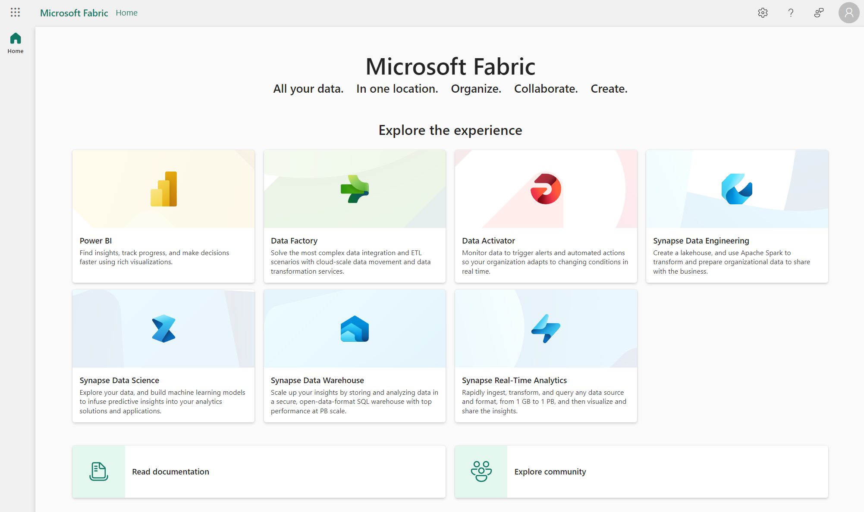
Notes:
Fabric User Interface is centered around Persona experience

Slide 14
Report Demo

Slide 15
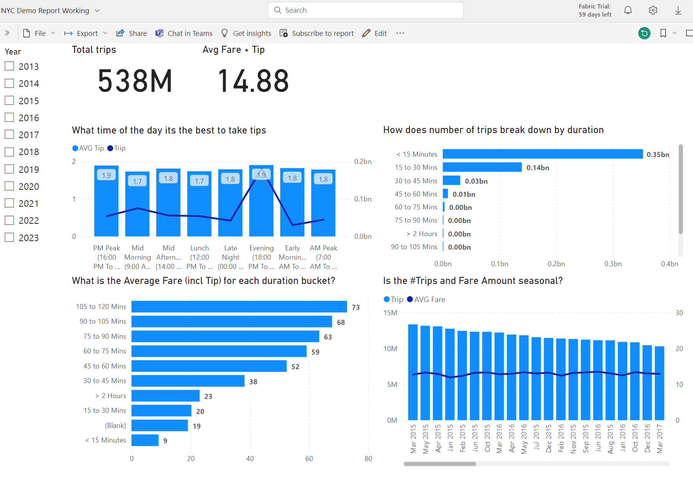
Report Demo
Direct Lake
New mode for large data volume
Overview
NYC Yellow Dataset
Parquet format
36Gb size
1.5 Million rows (538M filtered)
Notes:
https://app.powerbi.com/groups/3d4eb8f2-f109-4301-a87e-be61e4f77563/reports/10bf55aa-5026-4cf4-b6d9-ae3f8c6a7bc6/ReportSection?experience=power-bi
Direct Lake mode is a groundbreaking new dataset capability for analyzing very large data volumes in Power BI. Direct Lake is based on loading parquet-formatted files directly from a data lake without having to query a Lakehouse endpoint, and without having to import or duplicate data into a Power BI dataset. Direct Lake is a fast-path to load the data from the lake straight into the Power BI engine, ready for analysis. The following diagram shows how classic import and DirectQuery modes compare with the new Direct Lake mode
Direct Lake is supported on Power BI Premium P and Microsoft Fabric F SKUs only. It's not supported on Power BI Pro, Premium Per User, or Power BI Embedded A/EM SKUs.

Slide 16
Fabric Pricing

Slide 17
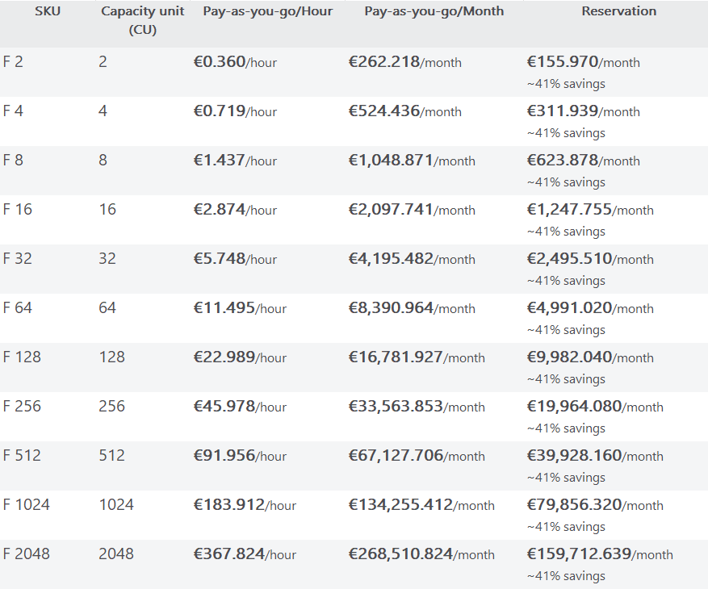
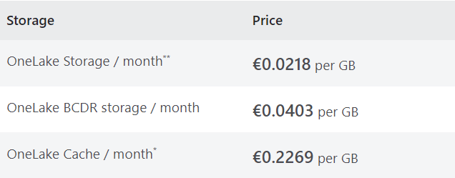
Microsoft Fabric Pricing
Fabric Capacity
Compute for fabric workloads
Spark Compute included
Networking
Cross-region data transfer may apply
Storage
Pricing
Fabric Capacity Reservations
22/11/2023, for North Europe region
Notes:
Pricing is a sum of following factors: Capacity + Storage and potentially Networking (in case if you’re working with data from multiple regions).
Publishing/authoring reports requires PowerBI Pro license for all SKUs.
F64 SKU is similar to PowerBI Premium capacity.
Reservations – reserves Fabric capacity for 12 months period.
Pricing
https://azure.microsoft.com/en-us/pricing/details/microsoft-fabric/
Save costs with Microsoft Fabric Capacity reservations
https://learn.microsoft.com/en-us/azure/cost-management-billing/reservations/fabric-capacity
(content sharing to users without a per-user licence is available only at Fabric SKUs F64 and above).
Two options:
PAYG
Reserved capacity (similar price to PowerBI Pro) – coming later

Slide 18
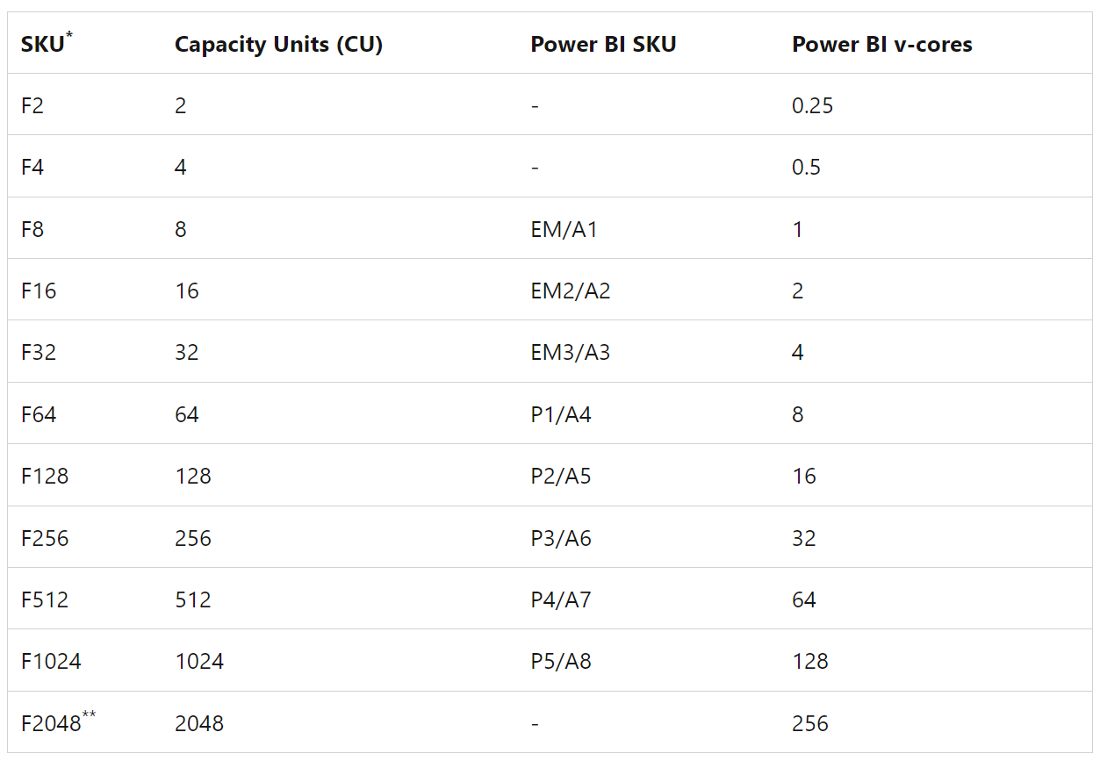
F64 Capacity
Fabric Premium Capacity
Share reports in Premium Capacity
Included in MACC
Direct Lake
Fast Reporting over very large datasets
Query Data Lake Directly
Report Model Sizing
100Tb Maximum Storage (all models)
400Gb Max Model Size
Notes:
Formerly known as PowerBI premium
Direct Lake
https://learn.microsoft.com/en-us/power-bi/enterprise/directlake-overview
Unlimited number of Reader Report users
Spark Compute time for ETL included
Direct Lake - allows reports from large datasets
Smoothing - flattens Compute usage over time to allow for usage spikes
Maximum Storage - 100Tb
Maximum Model Size - 400Gb
What is Power BI Premium?
https://learn.microsoft.com/en-us/power-bi/enterprise/service-premium-what-is

Slide 19
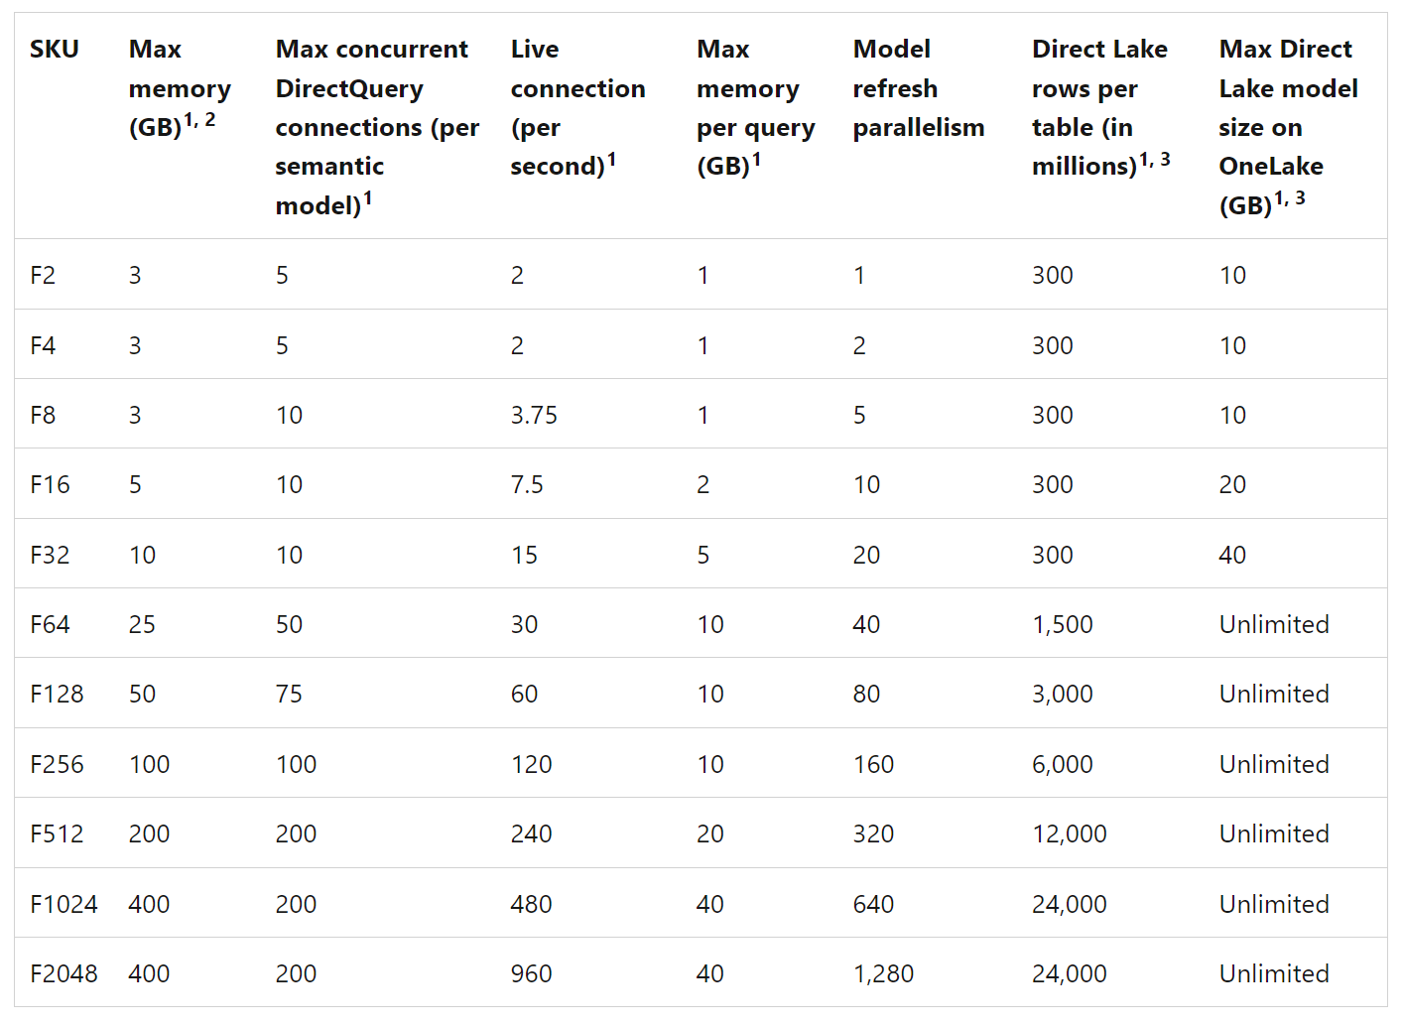
Resource guardrails
Notes:
https://learn.microsoft.com/en-us/power-bi/enterprise/service-premium-what-is#semantic-model-sku-limitation

Slide 20
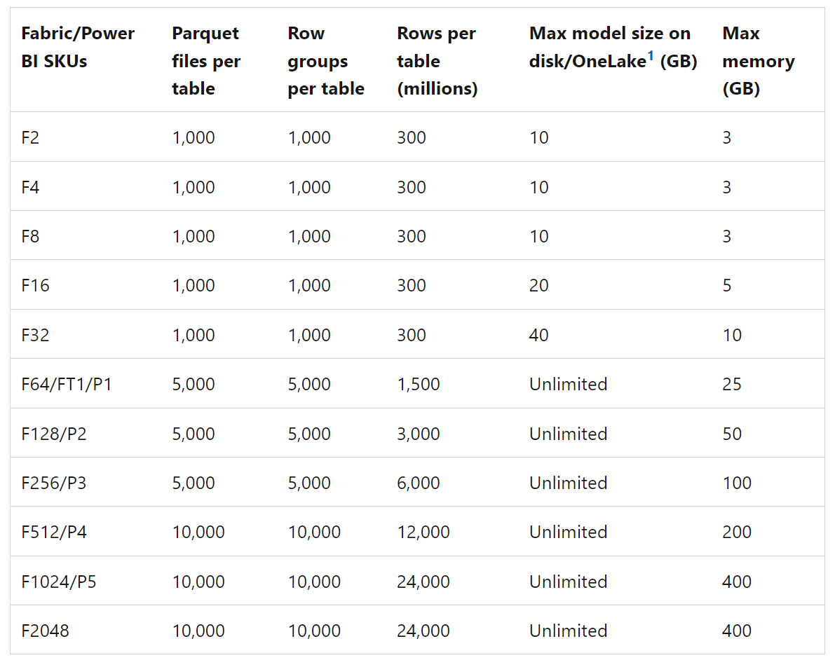
Resource guardrails
Notes:
https://learn.microsoft.com/en-us/power-bi/enterprise/directlake-overview#fallback

Slide 21
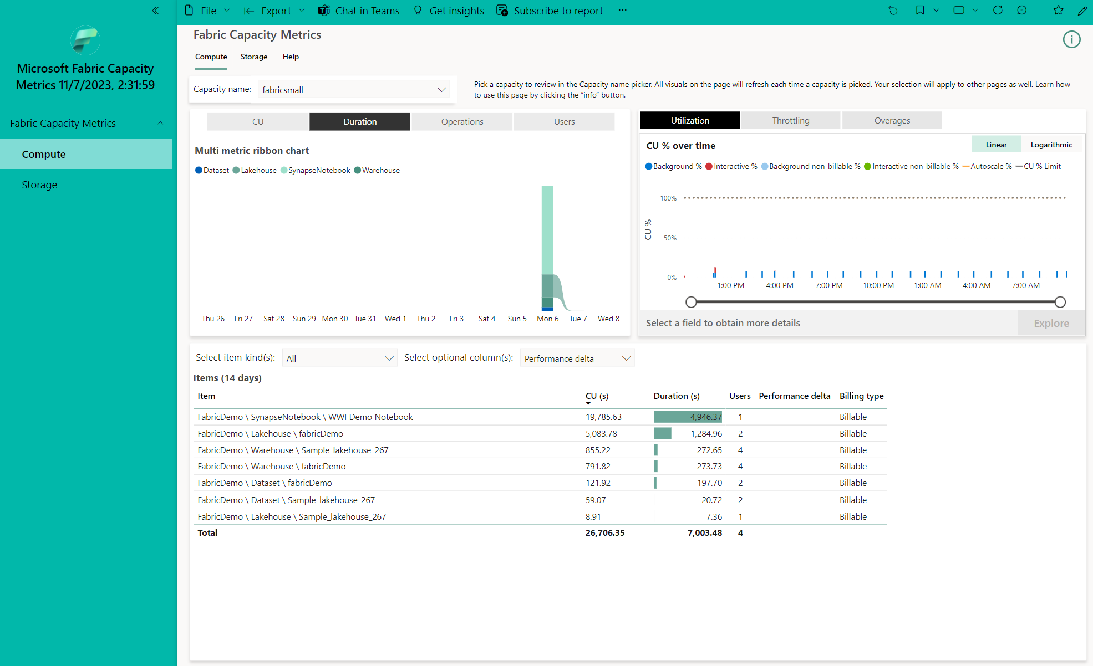
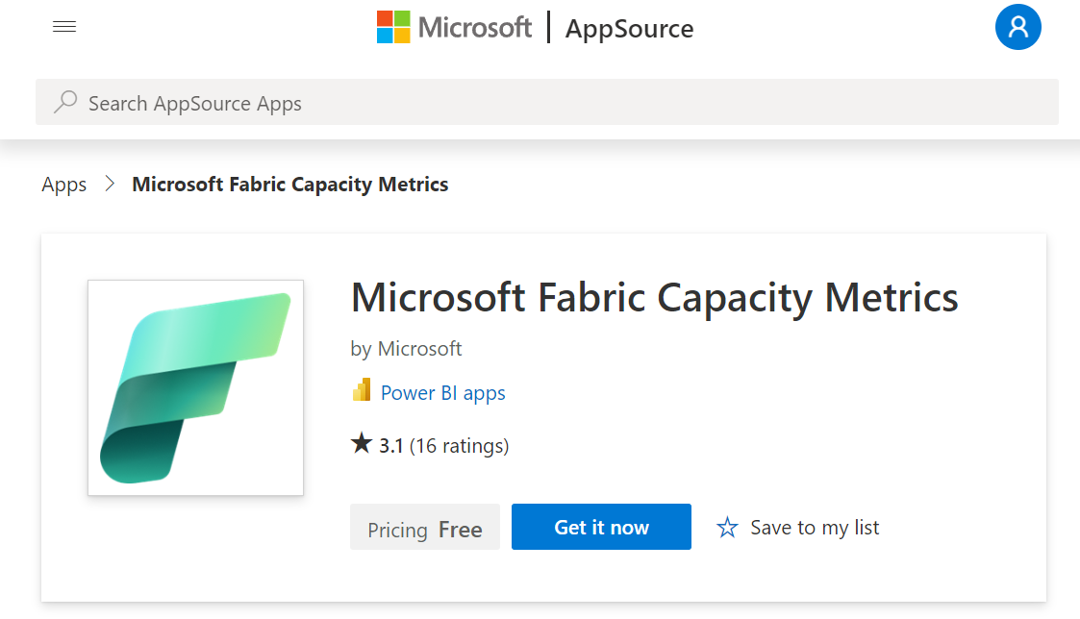
Sizing
Install Fabric Capacity Metrics App
Notes:
https://learn.microsoft.com/en-us/fabric/enterprise/metrics-app-install?tabs=1st

Slide 22
Enable Fabric in your tenant

Slide 23
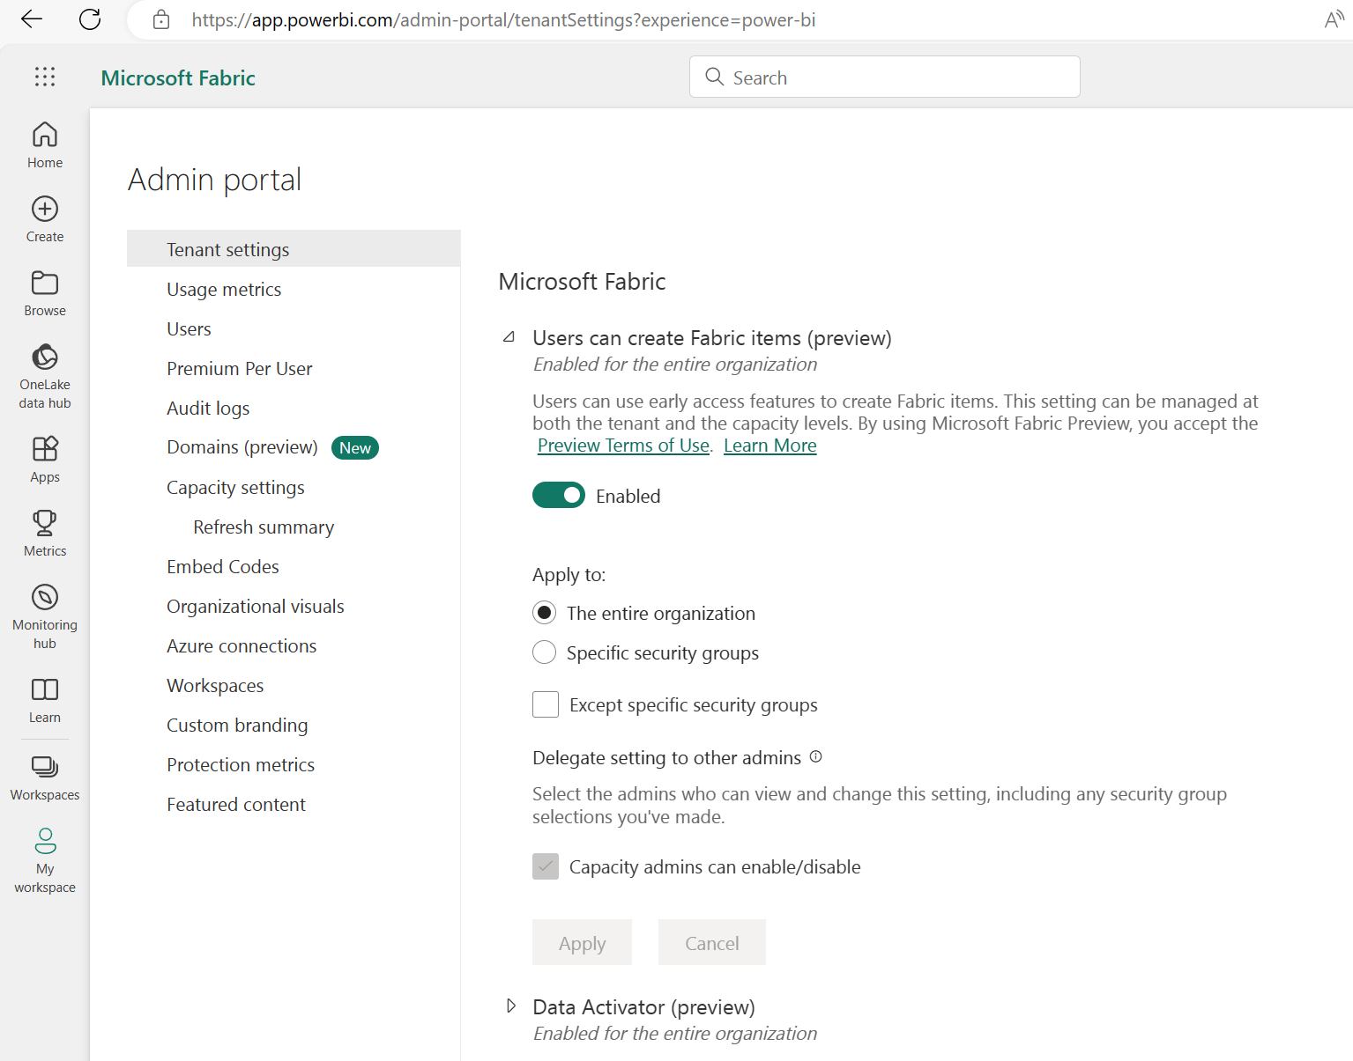
Fabric
Administrator settings
Enable Fabric functionality for all users or per security group

Slide 24
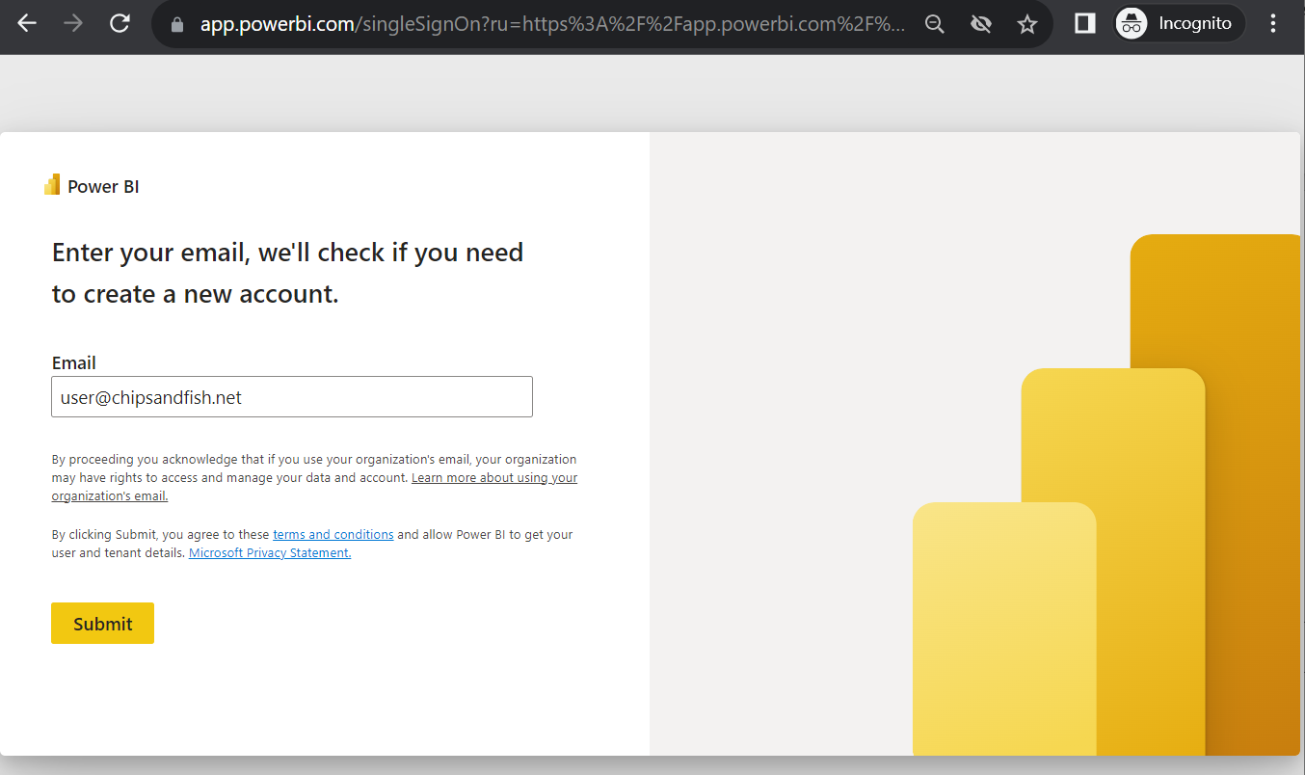
Fabric
User Sign Up experience
Navigate to
https://app.powerbi.com

Slide 25
Other resources

Slide 26
Copilot in PowerBI Video
https://www.youtube.com/watch?v=wr__6tM5U6I
Notes:
https://www.youtube.com/watch?v=wr__6tM5U6I

Slide 27
Additional Resources
https://Aka.ms/FabricLicensing
aka.ms/FabricRoadmap
Notes:
https://learn.microsoft.com/en-us/fabric/enterprise/licenses

Slide 28

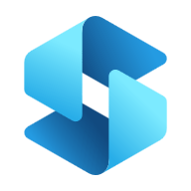




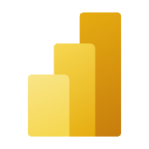

Microsoft Fabric
Microsoft Synapse
Data Factory
Synapse
Data Engineering
Synapse
Data Science
Synapse
Data Warehouse
Synapse
Real-Time Analytics
Power BI
Data Activator
OneLake
Notes:
Vs Synapse comparison short
Azure Data Factory provides a standalone experience for creating Pipelines.

Slide 29
Fabric vs Synapse, Nov’23
Fabric
Pros
SaaS
PowerBI included in price
Consolidated feature set
Scalable compute
Combined Compute: Spark, Analytics and PBI
Includes Data Activator
Includes Synapse capabilities (*)
Integrated Persona experience
Native MLFlow endpoint
Cons
(*) Active Development
No Synapse Link
Synapse
Pros
More flexible deployment
Serverless pools vs Dedicated Pools
Separately provisioned Compute for Spark, DWH
Mature
Synapse Link for (SQL, CosmosDb, etc)
Cons
Azure Synapse Studio
Azure portal for infra management
PaaS
Prev Gen
Notes:
Fabric is Microsoft Azure Consumption Commitment (MACC) eligible.
https://powerbi.microsoft.com/en-au/pricing/
Data Activator
Data Activator is a no-code experience in Microsoft Fabric for automatically taking actions when patterns or conditions are detected in changing data. It monitors data in Power BI reports and Eventstreams items, for when the data hits certain thresholds or matches other patterns. It then automatically takes appropriate action such as alerting users or kicking off Power Automate workflows.
For Synapse, Data Activator can be realised with stream processing tech Kafka, Event Hubs, etc

Slide 30
One Lake
Storage features
Shortcuts
External Tables
Stored Anywhere
Many File Formats
PARQUET
CSV
AVRO
JSON
Delta Tables
Fast
Compliance built-in
Notes:
File Formats:
And any Apache Hive supported formats as expected.

Slide 32
Microsoft Fabric Pricing
Asdfasdfasdf

